Slide 1
Moving to PBR
Sébastien Lagarde & Charles de Rousiers
Notes:
Hi everyone, my name is Sébastien Lagarde and, together with Charles de Rousiers, we will be presenting our work on moving the Frostbite engine to Physically Based Rendering (PBR).

Slide 2
Acknowledgments
Contributions from *many* people
This talk and the course notes are about:
Summarizing all of the steps to move an engine to PBR
Using the state of the art in our base implementation
Small improvements in quality
Notes:
First, I would like to mention that this work has been made possible thanks to many people – not just within the Frostbite team, but also from the global rendering community.
Our base implementation follows the state of the art for PBR, as most other engines are doing it.
We have also made some small quality improvements.

Slide 3
Disclaimer
This presentation is about:
A high level overview
Steps to move to PBR
Courses notes come with full details and code
…
Notes:
This presentation gives a high-level overview of our work and covers a few of the steps in moving to PBR. All of the details – including code – are available in the course notes.

Slide 4
What is the scope of PBR?
Notes:
What is the scope of PBR for us?
Well, we have matter…

Slide 5
What is the scope of PBR?
Light
Notes:
A light interacting with the matter…

Slide 6
What is the scope of PBR?
Environment
Light
Notes:
Environmental lighting – from the sky and other elements in the scene…

Slide 7
What is the scope of PBR?
Environment
Light
Camera
Notes:
…and an observer.

Slide 8
What is the scope of PBR?
1
Materials
Environment
2
Lighting
3
Camera
Light
Camera
Notes:
For us, PBR means these three components: Materials…

Slide 9
What is the scope of PBR?
1
Materials
Environment
2
Lighting
3
Camera
Light
Camera
Notes:
…lighting…

Slide 10
What is the scope of PBR?
1
Materials
Environment
2
Lighting
3
Camera
Light
Camera
Notes:
…and the camera.
But before talking about these components, the first thing to do when working with PBR is to develop…

Slide 11
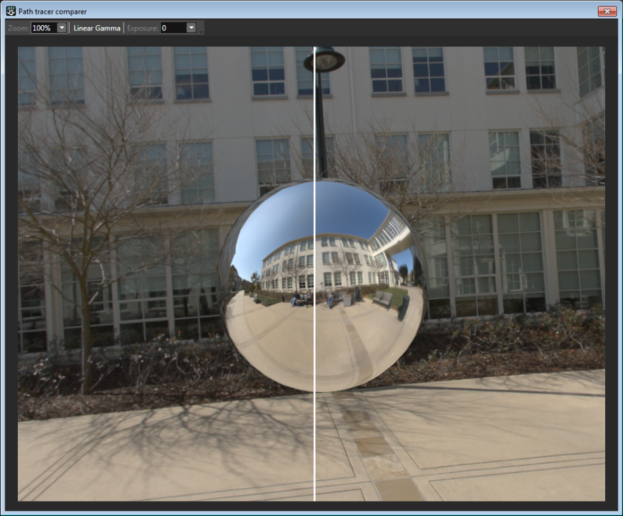
Reference framework
Need good reference
Export to offline path-tracer
In-engine reference
Notes:
…a reference framework.
From the beginning, we tried to find a way to compare our results.
We built an exporter from Frostbite to Mitsuba, which is an offline path tracer.
But the process was too slow. So, to rapidly validate our rendering, we have built an in-engine reference mode.

Slide 12
Materials
Notes:
So, materials…

Slide 13
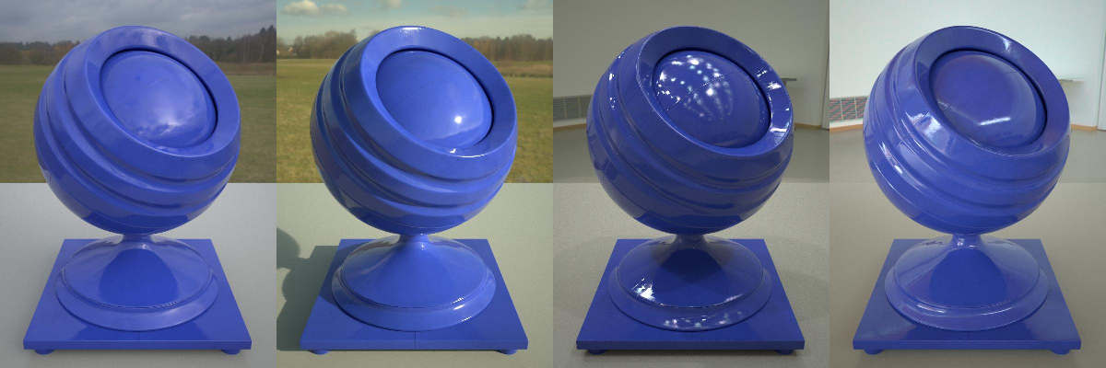
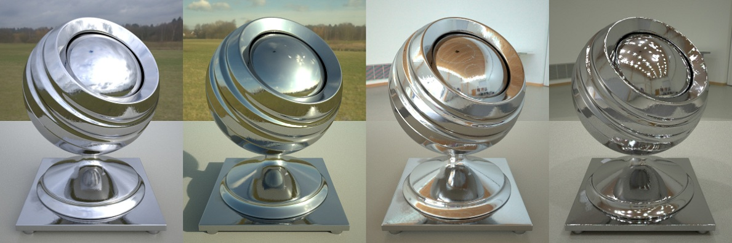
Material – Standard Model
Standard material
80% of appearance types
Model
Specular: Microfacet model with GGX NDF
Diffuse: Disney’s model
Other material types
Subsurface material
Single layer coated material
Dielectric
Conductor
Notes:
Our standard material is composed of a diffuse term and a specular term – nothing new there. It allows us to represent 80% of our cases.
We support other kinds of material through additional BRDFs – such as clear coating or subsurface scattering – but we will not discuss them here.

Slide 14
Material – Specular
Height-
Correlated
Smith
[Heitz14]
Schlick
GGX
F(v, h, f0)
G(v, l, h )
D(h, ɑ)
F_{s}(v, l) =
4 (n.v)
(n.l)
Notes:
Our specular term is a traditional microfacet model, using Schlick’s approximation of the Fresnel function, and the GGX Normal Distribution Function (NDF).
One small deviation from common practice is the geometric term, which does not use the regular (uncorrelated) Smith function. Instead we use a height-correlated version, as it is “theoretically” more correct – see Eric Heitz’ course notes for a thorough discussion.

Slide 15
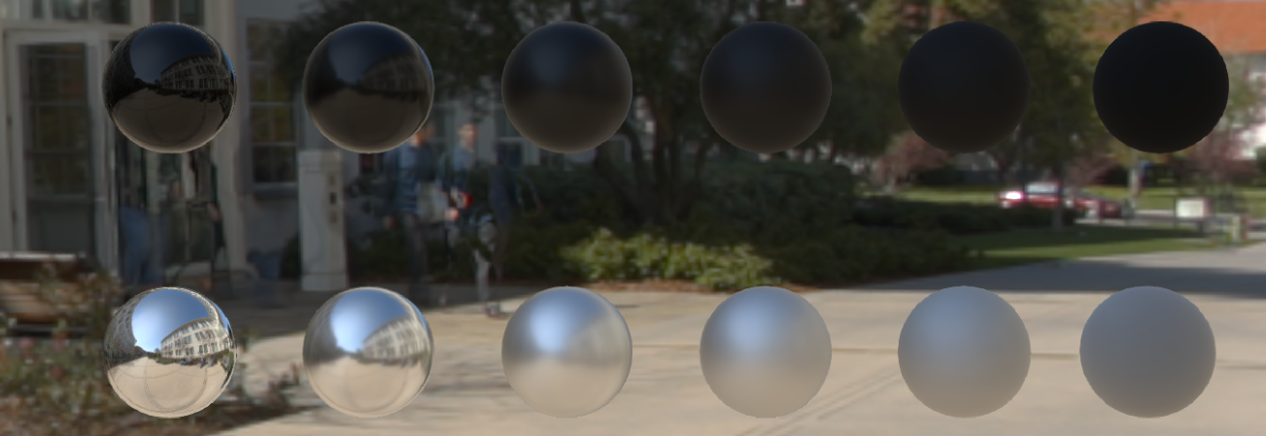
Material – Specular
Standard (uncorrelated) Smith G Term
Dielectric
Metal
Notes:
Here is a simple comparison. First the uncorrelated Smith G term, for a dielectric material with black diffuse (top) and a metal material (bottom).

Slide 16

Material – Specular
Height-correlated Smith G Term
Dielectric
Metal
Notes:
And here the height correlated version. The difference is subtle but noticeable for high roughness values (on the right).

Slide 17


Material - Specular
Correlated
Standard
Height-correlated Smith G Term
Notes:
Here’s a side-by-side comparison for high roughness.

Slide 18
Material – Diffuse
Disney Diffuse [Burley12]
Coupled roughness between diffuse and specular
Retro-reflection
Notes:
For our diffuse term, we wanted to couple the roughness of the specular term and the one from the diffuse term. We also wanted to get retro-reflective behavior when the roughness is high.
We have investigated proper derivations from the GGX distribution as [Gotanda14], but we went for Disney’s diffuse model (from [Burley12]) as it is simple and good enough.

Slide 19
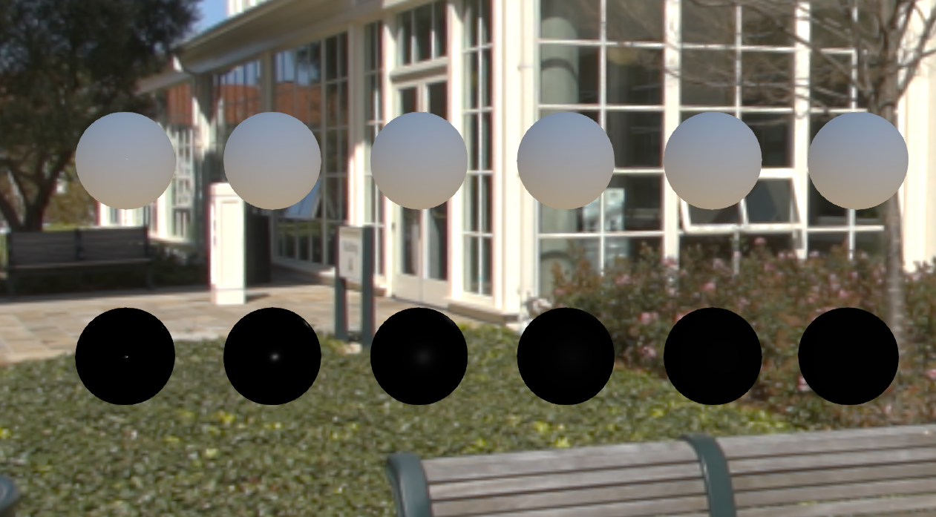
Material – Diffuse
Lambertian Diffuse
Smooth
Rough
Notes:
As a quick reminder of Disney’s diffuse model, here is a comparison. This is Lambertian diffuse, which is the same for all roughness values.

Slide 20

Material – Diffuse
Disney Diffuse
Smooth
Rough
Notes:
Here is Disney’s diffuse, which is a bit darker at low roughness, and brighter at high roughness. Subtle, but it can make a difference.

Slide 21
Material - Diffuse
Disney
Lambert
Disney
Lambert
Disney’s Diffuse
Smooth
Roughness
Notes:
Here is a side-by-side comparison, with low roughness (left), and high roughness (right).

Slide 22
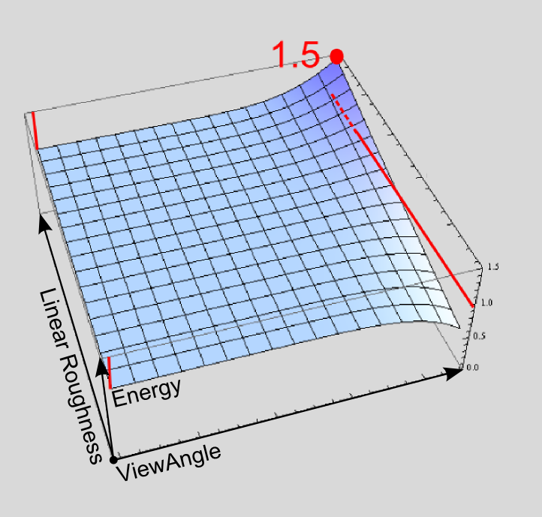
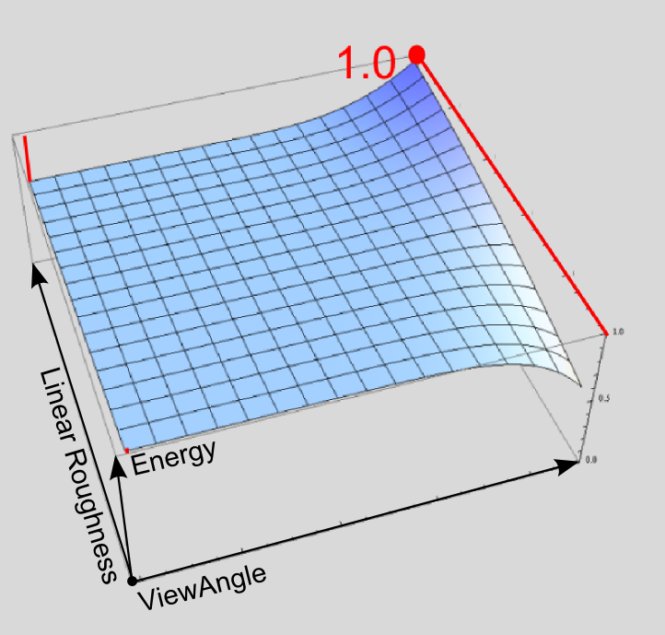
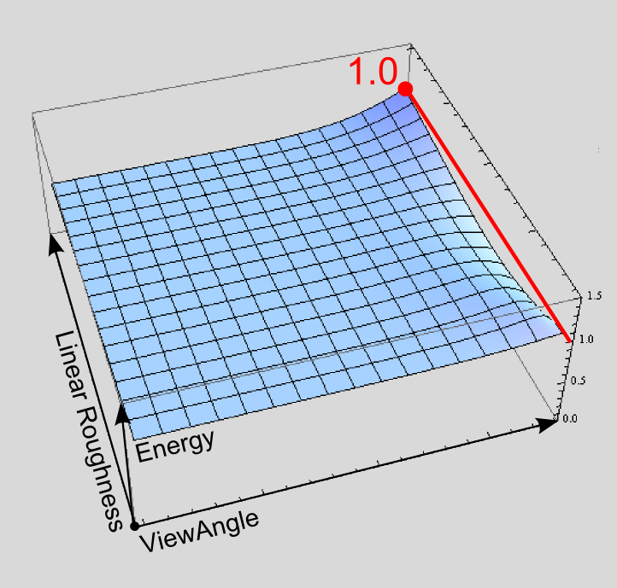
Material – Diffuse
Original Disney Diffuse
Renormalized Disney Diffuse
Diffuse + Specular
Notes:
One issue we had with the original Disney diffuse term is that it does not respect energy conservation: in some cases, the reflected light can be higher than the incoming illumination.
We have applied a simple linear correction to ensure that the hemispherical-directional reflectance is below 1 when we add the specular and the diffuse terms together.

Slide 23
Material – Diffuse
Disney Diffuse
Notes:
For comparison, here is the un-normalized term…

Slide 24

Material – Diffuse
Renormalized Disney Diffuse
Notes:
…and here’s the renormalized version.
Notice that the model appears darker, particular for high roughness values (right), where there is more retroreflection.

Slide 25

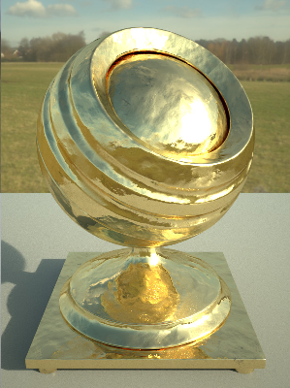



Material – Parameterization
Normal
Normal
BaseColor
BaseColor
Smoothness
Smoothness
Reflectance
Reflectance
Metallic
Metallic
Notes:
For the input values of the diffuse and specular terms, we have again followed Burley’s approach, which decouples dielectrics and metals for easier authoring.

Slide 26

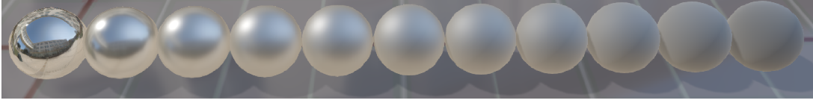
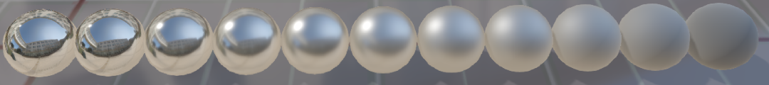
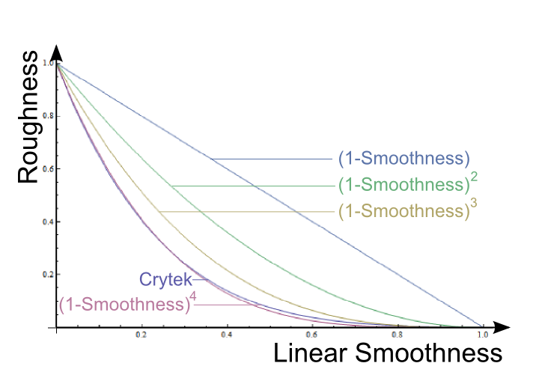
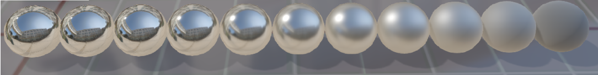
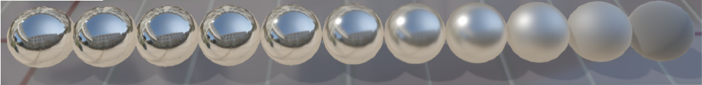
Material – Parameterization
Smoothness
(1 –Smoothness)
Burley12
2
(1 –Smoothness)
3
(1 –Smoothness)
4
(1 –Smoothness)
Notes:
We chose to expose ‘smoothness’ to the artists rather than roughness, because white = smooth is more intuitive for them.
We also experimented with various remapping functions in order to get ‘perceptually linear’ roughness. Again, we ended up using Burley’s approach of squaring the roughness.

Slide 27

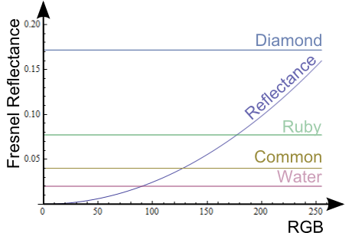
Material – Parameterization
Micro occlusion
Common
Gem stones
0
128
255
Reflectance
Fresnel0
0
1
Dielectrics
Conductors
Notes:
‘Reflectance’ controls the Fresnel value for dielectric materials.
It represents a subset of the full f0 range, in order to get more precision.
We also wanted to fit a couple of semantics into it.
- The bottom range is dedicated to specular micro occlusion.
- The mid-value is remapped on the common 4% of reflectivity
- The top range is dedicated to gem stones. We have bounded it to 16%, even if some gemstones like diamond are around 17%. The goal was to keep the decoding of f0 as simple as possible.

Slide 28
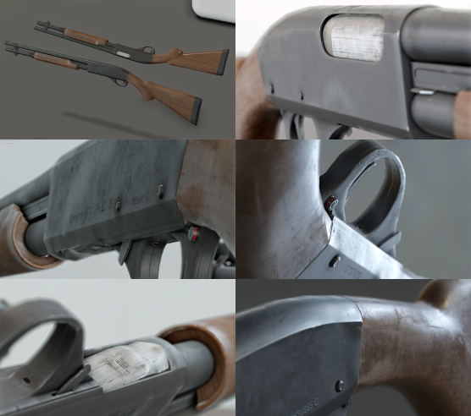
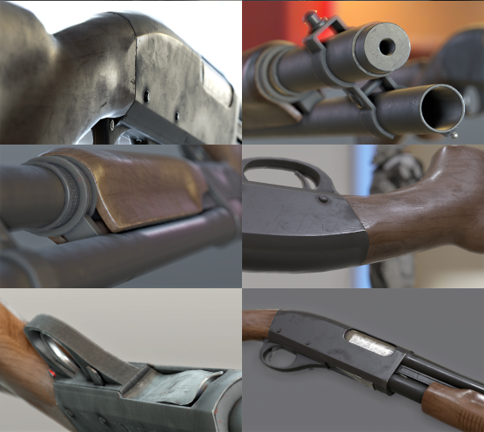
Material – Parameterization
Notes:
An example of in-engine results.

Slide 29
Lighting
Notes:
That covered the material section. Now let’s take a look at how light interacts with these material properties.

Slide 30
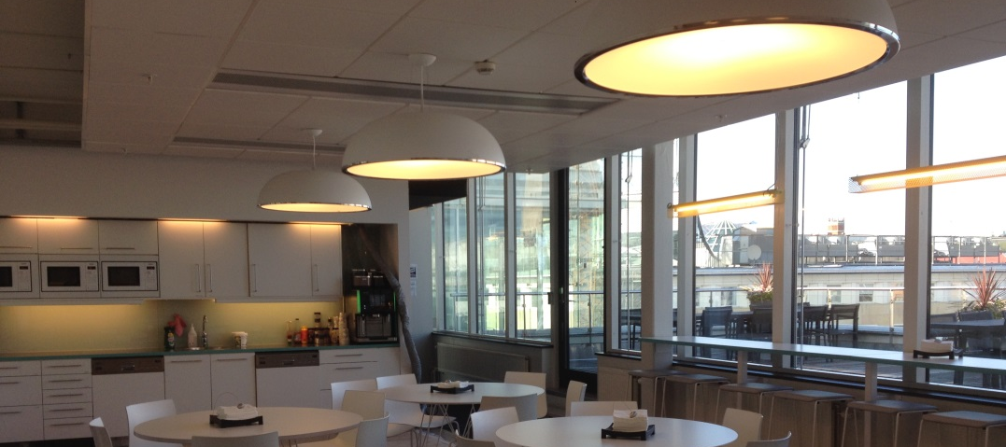
Lighting
Notes:
In the real world, an object will receive lighting from everywhere.

Slide 31
Lighting
Notes:
Analytical lights surrounding the space.

Slide 32
Lighting
Notes:
Outside, from the sun and the sky.

Slide 33
Lighting
Notes:
But also the entire surroundings.
One important point to note here is that all lights are visible at the same time, with different intensity ratios.

Slide 34
Lighting
Lighting coherence
All BRDFs must be integrated properly with all light types
All lights need to manage both direct and indirect lighting
All lighting is composed properly (SSR/local IBL/…)
All lights have the correct ratio between each other
Notes:
This highlights that coherence in lighting is key for achieving realistic images.
Coherence in an engine needs to be respected in several places:
- All of the BRDFs must be integrated properly with all light types – this includes area lights and image-based lights (IBLs).
- All lights need to affect both direct and indirect lighting. For instance, any new area light type must also be added to the radiosity system.
- When lighting with different techniques like screen-space reflections (SSR) or light probes, all lighting must be combined properly – to avoid ‘double counting’, for example – and it must transition smoothly.
In addition, the intensity ratios between all of the lights needs to be correct.

Slide 35
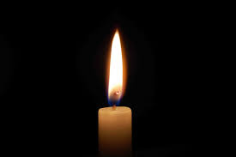
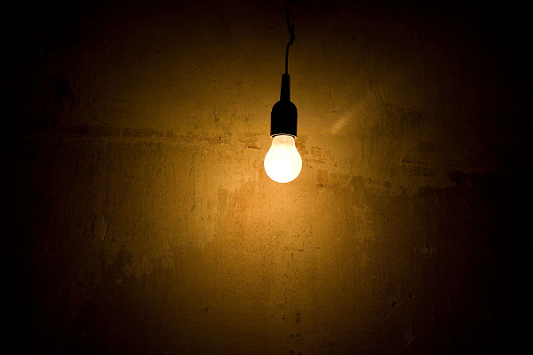
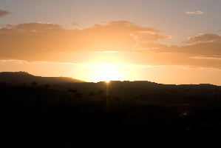
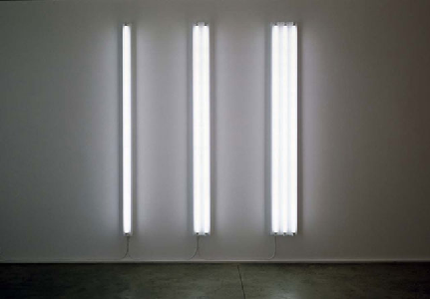
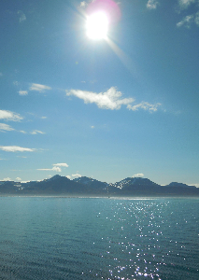
Lighting – Units & Frame of Reference
Light Power
Notes:
We know that light sources span a wide range of values: a candle emits little light, the sun is super bright.
In the past, artists have typically defined an arbitrary value for the strongest light of a scene. Then they define the intensity of other lights relative to this key light.
This can make it difficult to tweak the lighting, or reuse light setups.
A better approach is to use a common frame of reference…

Slide 36
Lighting – Units & Frame of Reference
15 lm
1 200 lm
2 600 lm
64 000 lux
Light Power
Notes:
By using a consistent unit system for light intensities – photometry for instance – one can determine accurate (physical) values for any given light source.
By having a single frame of reference, we can now ensure consistency for all our lighting, and we can reuse some lighting rigs on different scenes.

Slide 37
Lighting – Units & Frame of Reference
Luminous power
Illuminance
Luminance
Luminous intensity
Lumens
Lux
Candela/m
2
Candela
Photometric Unit System
Notes:
Frostbite’s entire lighting pipeline is in photometric units.
We use four types of units.

Slide 38
Lighting – Units & Frame of Reference
Punctual
Luminous power (lm)
Photometric
Luminous intensity (cd)
Area
Luminous power (lm), Luminance (cd/m²), or EV
Emissive
Luminance (cd/m²) or EV
Sun
Illuminance (lux)
Notes:
These are the various analytical light types found in Frostbite, with their corresponding units.
We will go through all of them.

Slide 39
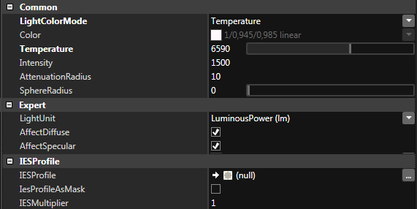
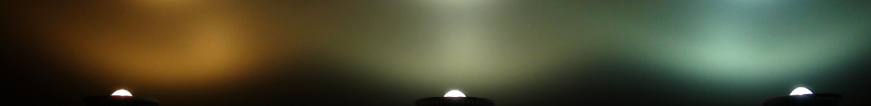
Lighting – Analytical Lights
1,000 k
10,000 k
Parameterization
Notes:
For our analytical lights, we have separated our light settings into intensity and color.
Artists use the appropriate units, depending on the light type (see previous slide).
For the color, they can choose to derive it from a color temperature.

Slide 40
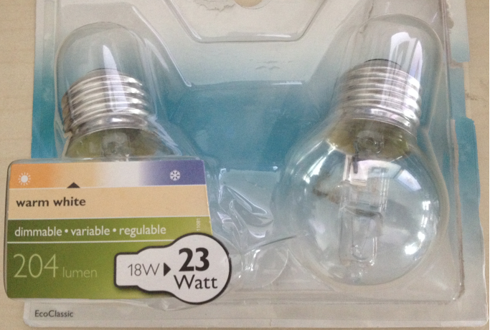
Lighting – Units & Frame of Reference
Notes:
Such settings are convenient because they can be taken from light bulb packages or gathered over the internet.

Slide 41
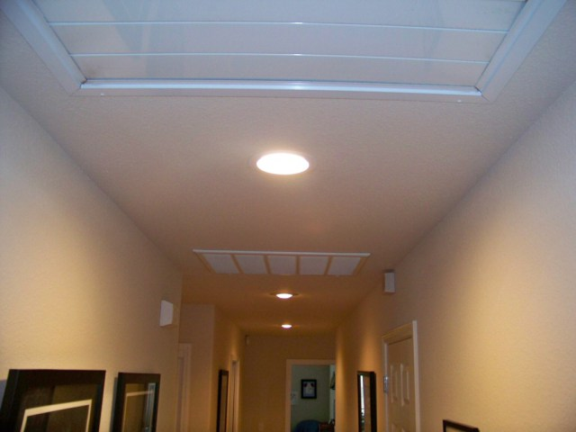
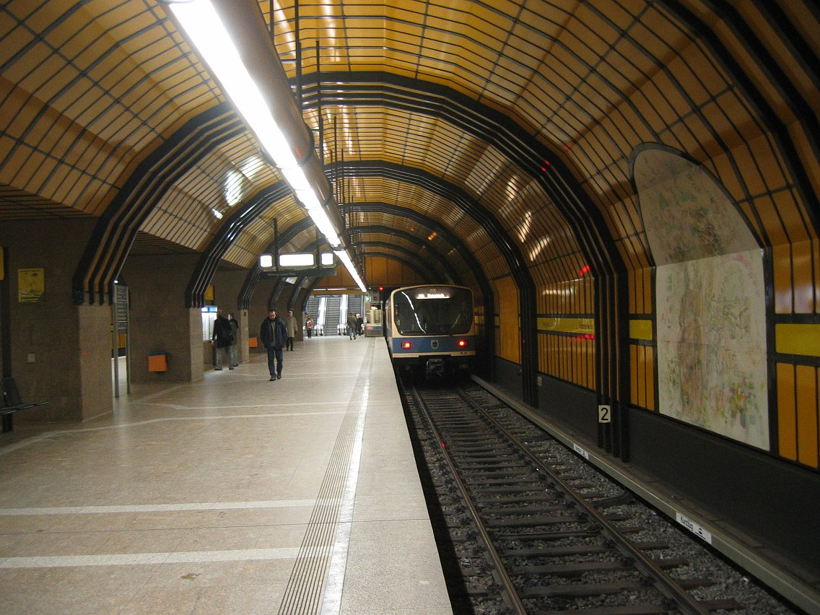
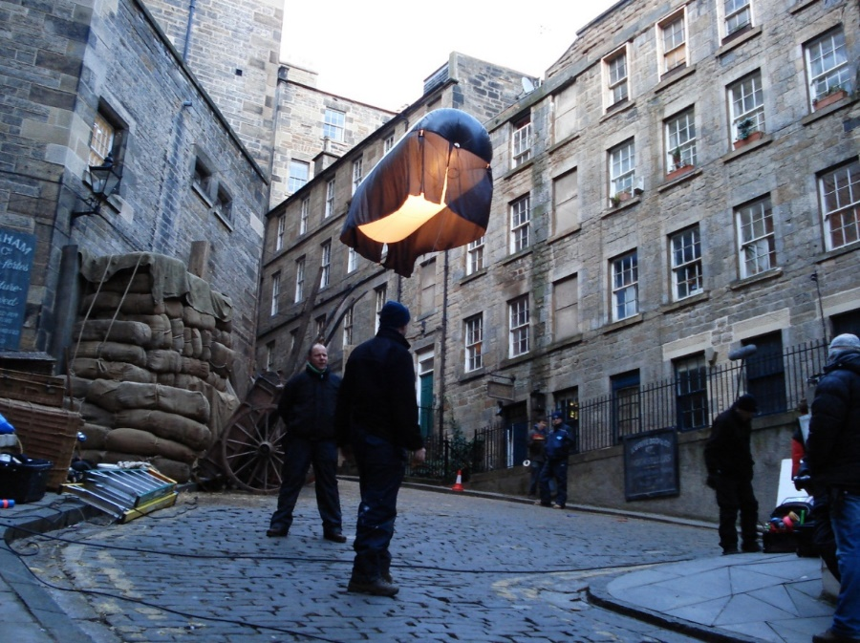
Lighting – Analytical Lights
Notes:
Real-world lighting is made up of area lights of various shapes.

Slide 42
Lighting – Analytical Lights
Punctual
Area
Point
Sphere
Spot
Disk
Frustum
Rectangle
Line
Tube
Notes:
To cover this variety, we support four different shapes: sphere, disk, rectangle and tube.
Each of these lights could have a simpler version, but only point and spot use a punctual light path, as they are more frequent due to their low cost.

Slide 43
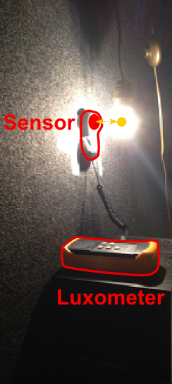
Lighting – Analytical Lights
Punctual lights
Unit: Lum. power (lm) or Lum. intensity (cd)
Use smooth attenuation [Karis13]
Attenuation
Radius
Falloff
Inverse square
Karis13
Distance
Notes:
Our punctual lights are pretty common. They follow the well-known inverse square law, and for performance reasons they attenuate to 0 when they reach a given attenuation radius.
For this we have adopted the smooth attenuation function presented by Brian Karis – see his 2013 course notes for details.
To validate our in-engine lighting equation, we performed real world measurements of a light bulb, and it turns out that the physics is correct!

Slide 44
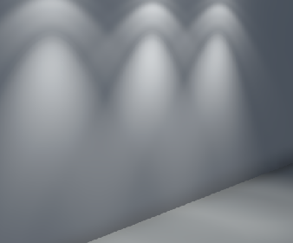
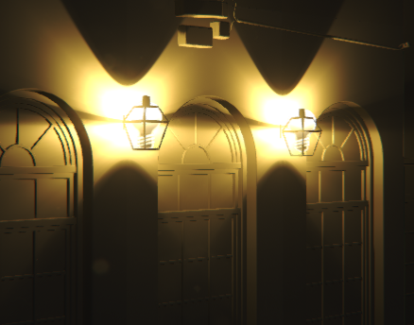
Lighting – Analytical Lights
Photometric lights
Unit: luminous intensity (cd)
Applied to point and spot lights
Measured
Simple / Isotropic
Profile
IES photometric
Profile
Artists
Notes:
An IES profile can be attached to our punctual lights.
The IES profiles have different intensity depending on the direction. They can come from real-world measurements – available from manufacturers’ websites – or they can be authored by artist in a creative way.

Slide 45
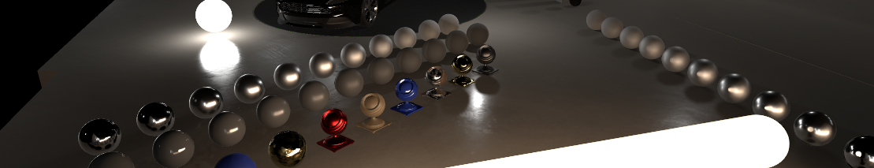
Lighting – Analytical Lights
Area lights
Unit: Luminous power (lm), Luminance (cd/m² or EV)
Separate diffuse and specular evaluation
Notes:
Area lights should be ’first-class citizens’ of a PBR engine. Sadly, they are quite complex to implement and in Frostbite they are currently not ready for production.
We have separated the evaluation of area lights into diffuse and specular components.

Slide 46
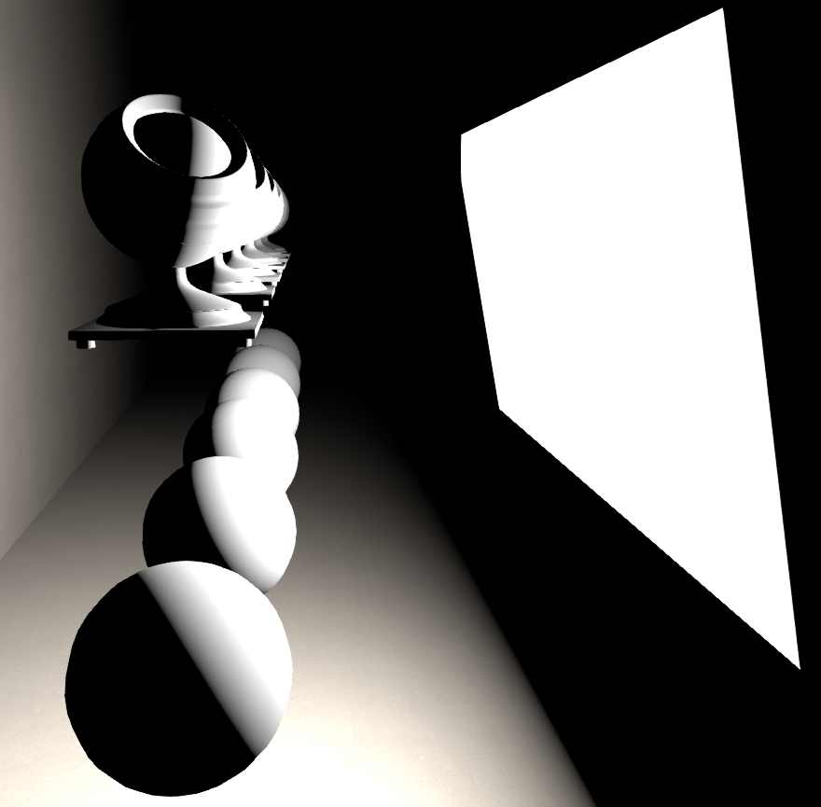
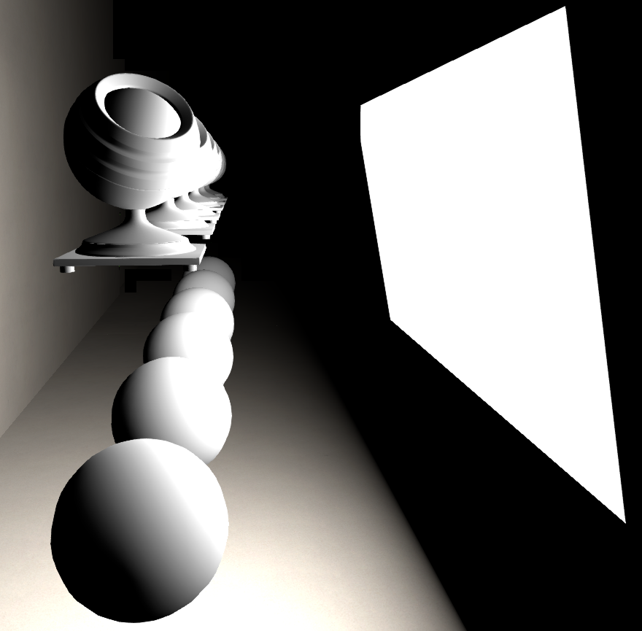
Lighting – Analytical Lights
Area lights
Large area light
Horizon handling
Without horizon handling
With horizon handling
Notes:
Correctly handling the diffuse part is key to obtaining the soft lighting provided by a large area light.
When lit with large area lights, objects should exhibit wrapped lighting. To have correct lighting intensity in this wrapped region, it is important to consider the horizon.
This means that when the light starts to cross the plane defined by a given shading point and normal, the intensity must decrease. In Frostbite, all of our diffuse area lights account for this.

Slide 47
Lighting – Analytical Lights
Diffuse area lights
3 integration techniques:
Analytic
Form factors (radiosity) / view factors (heat transfer)
MRP
Solid angles x Most Representative Point lighting [Drobot14]
Structured sampling of light shape
Solid angles x average cos
Notes:
We have explored three integration techniques for diffuse area lighting.
The first one is based on analytic integration. The well-known ‘form factor’ from radiosity provides the exact result of the diffuse integration. There is an equivalent formulation referred to as the ‘view factor’ in heat transfer science.
The second relies on the ‘most representative point’ (MRP) method presented by Michał Drobot in his GPU Pro 5 article.
The third is something we call ‘structured sampling of the light shape’, which has been developed internally. The details and the code are in the course notes.

Slide 48
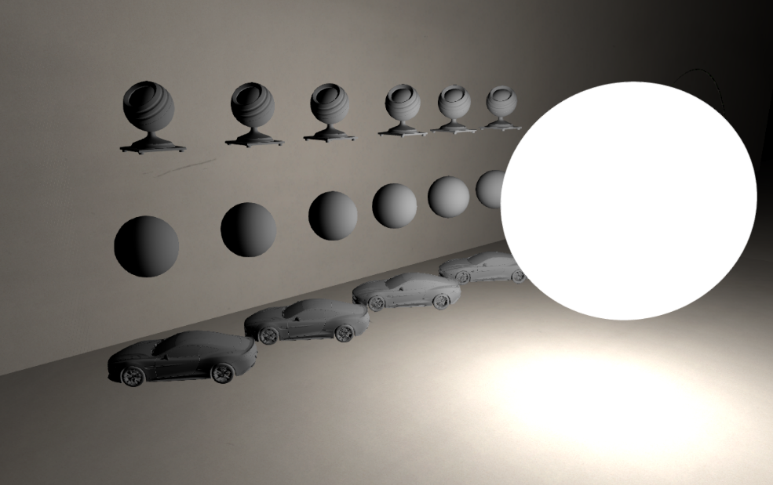
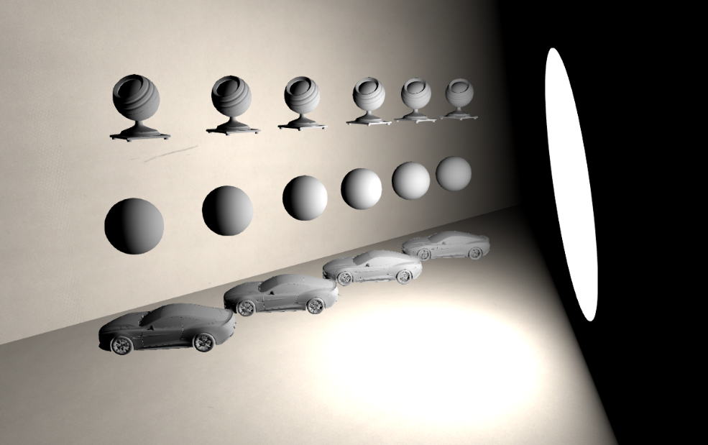
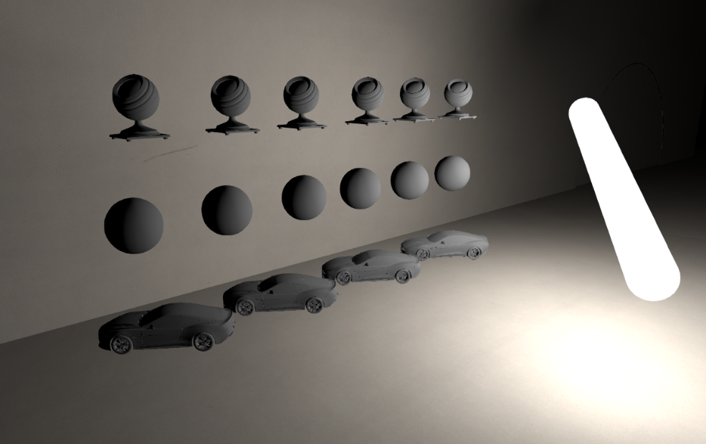
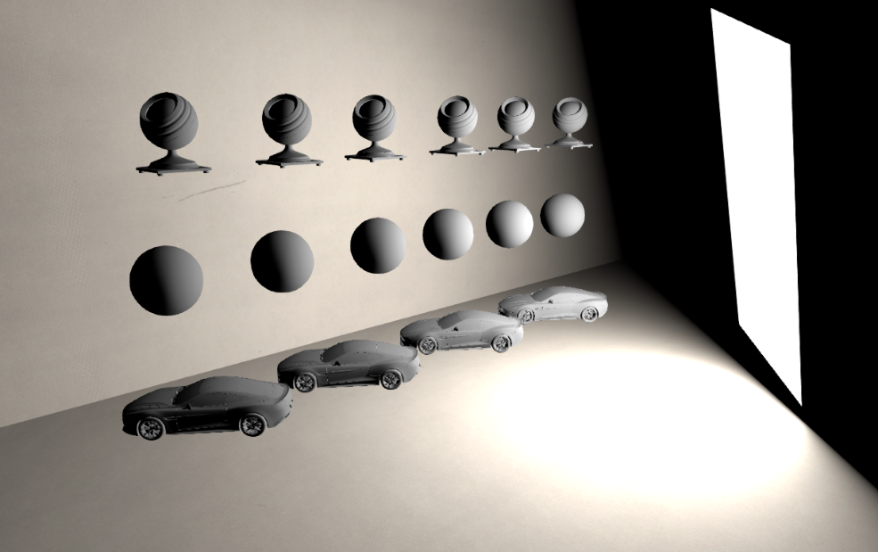
Lighting – Analytical lights
Sphere
Disk
View factor
View factor
Area lights: Diffuse term
Tube
Rectangle
Mix of sphere and rectangle
Structured sampling
Notes:
Here are some in-engine results.
We use either the MRP or the light position for the Disney diffuse term evaluation, depending on the light type.
(Note: these screenshots are with Lambert.)

Slide 49
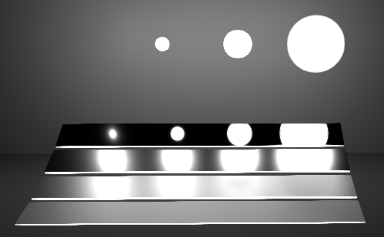
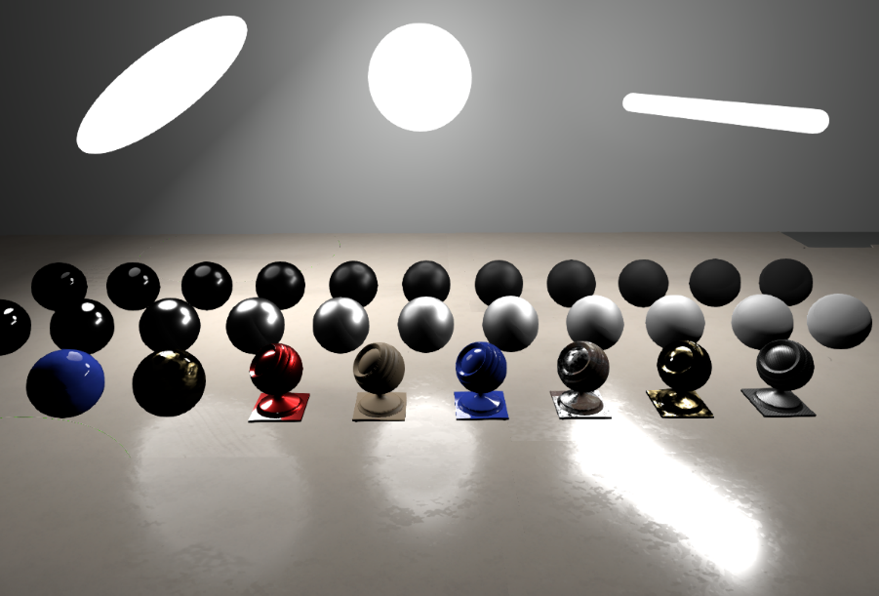
Lighting – Analytical Lights
Specular area lights
No satisfying method
Shortest distance to reflection ray with energy conservation [Karis13]
Notes:
For the specular area lighting, we haven’t found anything satisfying. We have experimented with our own method, as well as the MRP from Michał Drobot, and the ‘shortest distance to reflection ray’ approach presented by Brian Karis last year. However, none of them stand up to comparison with the reference.
We have chosen to use the approach presented by Karis because it is fast and still has good-looking results. However, we have not found a good energy-conserving term for disk and rectangle area lights.

Slide 50
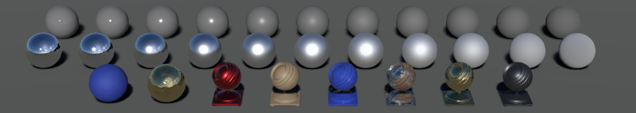
Lighting – Analytical Lights
Sun light
Units: Illuminance (lux)
Facing disk with non-null solid angle
Notes:
For the sun, the diffuse term is simply approximated with a single direction.
However, for the specular term, we use an oriented disk approximation. This has two benefits: firstly, it produces the actual solar disk shape for smooth materials, and secondly it helps to reduce specular aliasing (versus to a directional light).
We have also made some real-world measurements to determine valid ranges for sun (in lux). We found it to be above 100,000.

Slide 51
Lighting – Analytical Lights
Emissive surfaces
Units: Luminance (cd/m² or EV)
”Visible part” of a light
Does not emit light
Notes:
Emissive surfaces are complementary to area lights in Frostbite. They represent the visible part of area light sources.
They don’t emit light, but they use physical light units to ensure that their look matches the amount of light that is cast by the source.

Slide 52
Lighting – Image-Based Lights
Types of IBLs
Distant light probe
Local light probes
Screen-space reflections
Planar reflections
Notes:
Traditionally, ‘IBL’ has been used to refer to specular light probes (typically cube maps). However, we use the term to collectively refer to any form of image-based lighting.
This covers a few types:
- A distant light probe for parallax-free far lighting
- Local light probes, for local lighting, with parallax
- Screen space reflections, for close-range lighting (supporting glossy reflection)
- Planar reflections as an alternative to SSR

Slide 53
Lighting – Image-Based Lights
Types of IBLs
Distant light probe
Local light probes
Screen-space reflections
Planar reflections
Focus
Notes:
We will focus on the first two items in this presentation.

Slide 54
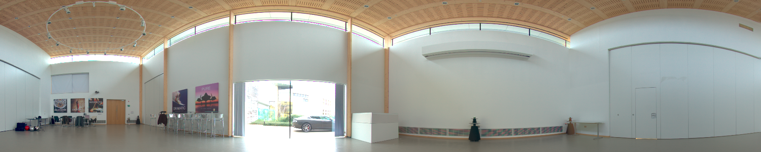
Lighting – Image-Based Lights
Units: Luminance (cd/m² or EV)
Source for the distant light probe
HDRI
Procedural sky
Notes:
For distant light probes, we support two types of sources: the light can be an actual HDR image acquired by artists, or it can come from a procedural sky.
Be careful when using HDR images, because they often don’t contain proper luminance values.
Most of the HDR images we’ve seen on the internet have bad ranges, and therefore don’t combine well with other light types.

Slide 55
Lighting – Image-Based Lights
Light probe lighting: Integral[Env. lighting x BRDF]
Pre-integration by separating:
Integral of Lighting x NDF, for V = N
Integral of BRDF, for all V & roughness values
Specular [Karis13]
&
Diffuse
Notes:
When dealing with light probes, we need to compute the integral of the product: lighting times BRDF.
This is a costly operation, so we rely on pre-integration and approximations.
(Click).

Slide 56
Lighting – Image-Based Lights
Light probe lighting: Integral[Env. lighting x BRDF]
Pre-integration by separating:
Integral of Lighting x NDF, for V = N
Integral of BRDF, for all V & roughness values
Specular [Karis13]
&
Diffuse
LD
DFG
Notes:
We used the decomposition covered by Brian Karis last year, which decouples the pre-convolved lighting (LD) from the BRDF (DFG).
We have also used the same decomposition for the Disney diffuse model.

Slide 57
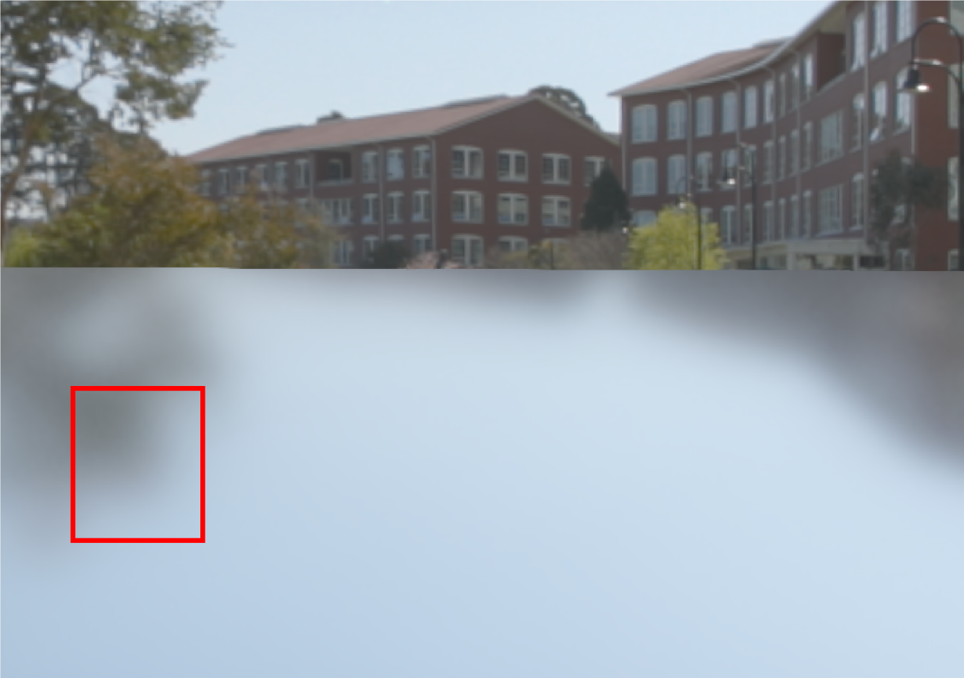
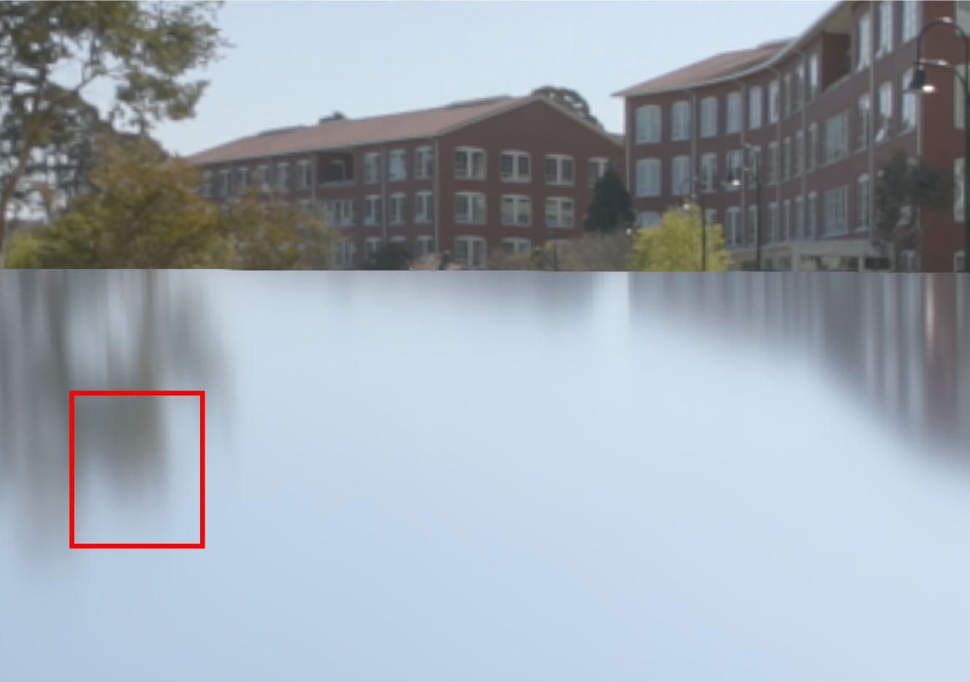
Lighting – Image-Based Lights
Light probe lighting: pre-integration
Isotropic approximation
Reference
Error due to LD pre-integration with V = N
Notes:
A remark here: the separation makes some significant approximations. The biggest of these is in the LD pre-integration, where the view vector is assumed to be aligned with the normal vector.
This results in a loss of anisotropy at grazing angles, which is quite noticeable on flat surfaces.
This is something we would like to address in the future.

Slide 58
Lighting – Image-Based Lights
Light probe lighting: pre-integration
LD needs to be computed each time the lighting changes
Needs to be fast (real-time capture / refresh)
Deals with HDR source
Integration method for LD
Importance sampling
Multiple importance sampling
Filtered importance sampling
Notes:
The LD pre-integration can be baked offline, but in our case, we need to also bake it at runtime as we support dynamic light probes.
This means that the computation needs to be fast, but it still needs to be robust enough to deal with high-contrast (HDR) illumination.
For this we tried importance sampling, but it was not enough, since importance sampling just the BRDF – not the lighting – can lead to noise in the case of high-contrast sources. We tried multiple importance sampling (MIS) to take account of both the BRDF and the lighting, but even if the convergence was faster, the shader cost was higher.
(Click)

Slide 59
Lighting – Image-Based Lights
Light probe lighting: pre-integration
LD needs to be computed each time the lighting changes
Needs to be fast (real-time capture / refresh)
Deals with HDR source
Integration method for LD
Importance sampling
Multiple importance sampling
Filtered importance sampling
Faster convergence
Notes:
Instead we use Filtered Importance Sampling (FIS), which employs mipmapped versions of the lighting in regions of lower sampling density. This introduces some bias, but it gives us faster convergence.

Slide 60
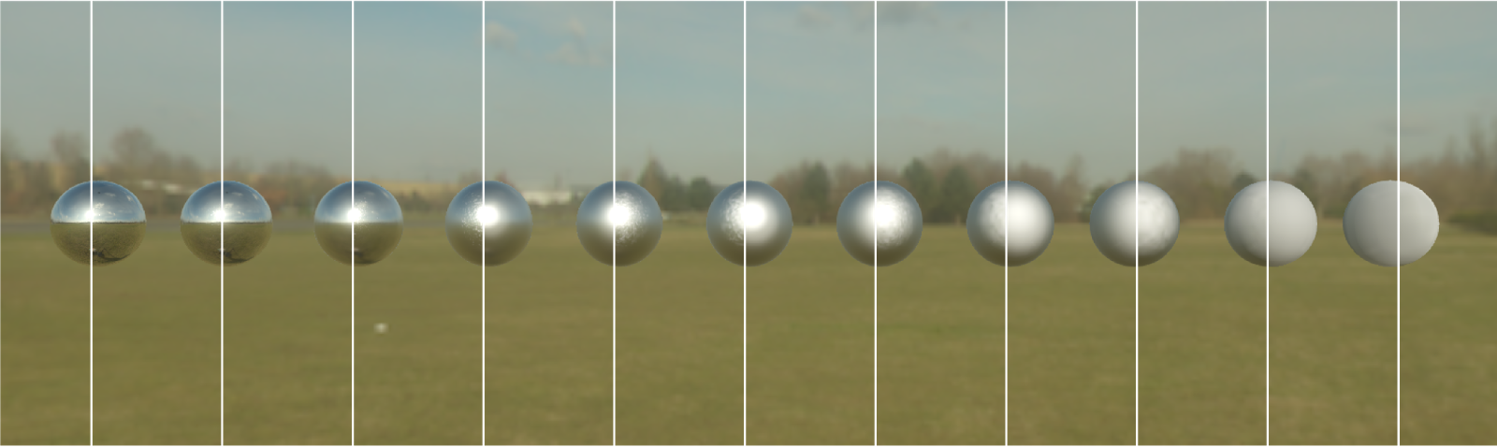
Lighting – Image-Based Lights
Light probe: pre-integration
Importance sampling
Filtered importance sampling
Notes:
Here is a comparison of the IS and the filtered approach.

Slide 61
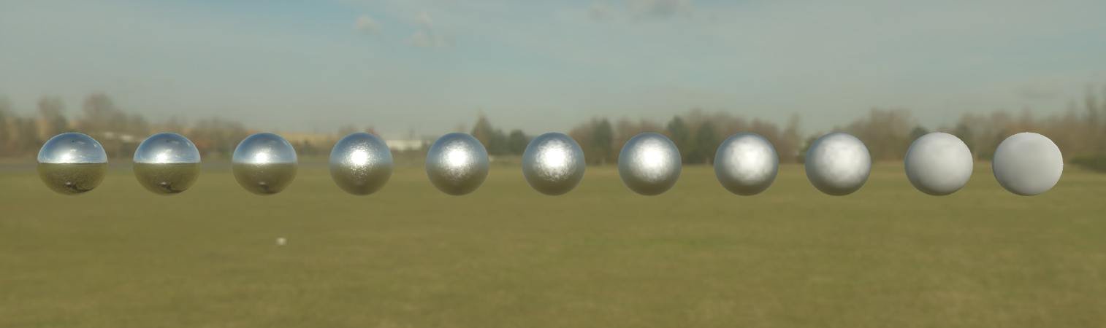
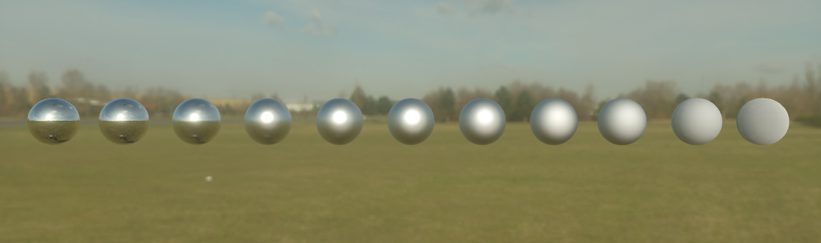
Lighting – Image-based lights
Light probe: pre-integration
Simple IS
Filtered IS
Importance sampling
Pre-Filtered importance sampling
Notes:
And close up.
In practice we use 32 samples.
We also don’t process the first MIP of the LD texture, in order to get a perfect specular mirror integration.

Slide 62
Lighting – Image-Based Lights
Runtime evaluation
Light probe
N
Notes:
At runtime, to evaluate the light probe for a view direction.
Given a surface...

Slide 63
Lighting – Image-Based Lights
Runtime evaluation
Light probe
N
Notes:
…we evaluate a material.

Slide 64
Lighting – Image-Based Lights
Runtime evaluation
Light probe
N
Notes:
…and we generally use the mirror direction to fetch the lighting from the cube map…

Slide 65
Lighting – Image-Based Lights
Runtime evaluation
Light probe
N
Notes:
…but the dominant direction of the BRDF is slightly shifted compared to the mirror direction.
Using this dominant direction instead of the mirror direction helps to improve the accuracy of the integration approximation.
We provide a formula to convert the mirror direction to the dominant direction in the course notes.

Slide 66
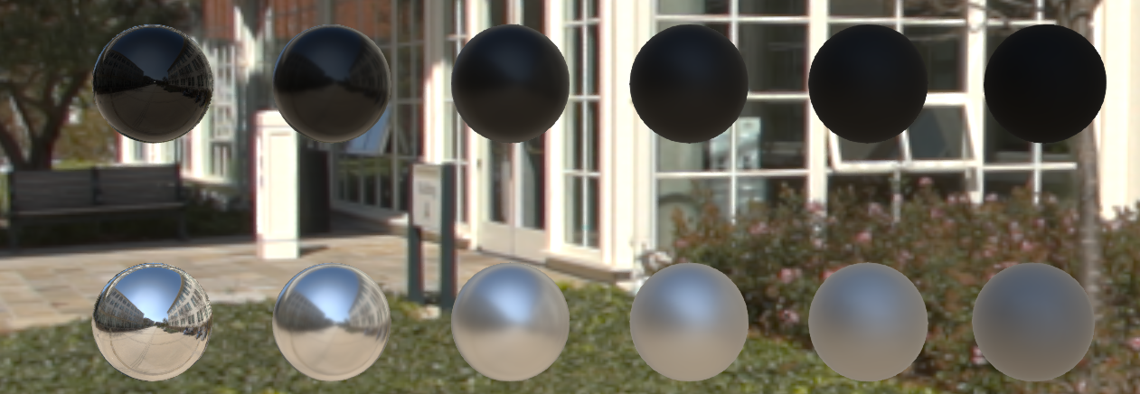
Lighting – Image-Based Lights
Mirror Direction
Dielectric
Metal
Notes:
Here is an example.

Slide 67

Lighting – Image-Based Lights
Dominant Direction
Dielectric
Metal
Notes:
The improvement for rough materials is quite noticeable.

Slide 68
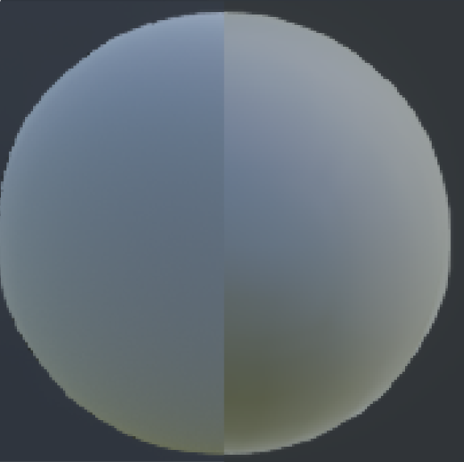

Lighting – Image-Based Lights
Reference
Mirror
Reference
Dominant
Main Direction
Notes:
In this close-up, we can see that using the dominant direction is a better approximation when compared to the reference.

Slide 69

Lighting – Image-Based Lights
Local light probes
Acquire surrounding geometry
Approximate local parallax: box & sphere proxy [Lagarde12]
Notes:
The local light probes capture the surrounding environment and use parallax correction via box and sphere proxies.

Slide 70

Notes:
So we have a scene…

Slide 71
Notes:
…we place proxy geometry, which approximates the surrounding geometry…

Slide 72
Notes:
…then we acquire the incident lighting at the center of this proxy…

Slide 73

Sky is handled by
distant light probe
RGB
Dielectric
Conductor
Notes:
…which provides us with incident lighting stored in a cube map that we can reproject onto the proxy.

Slide 74
Dielectric
Conductor
Notes:
The incident capture contains only the diffuse component, ignoring any view-dependent effects such as specular reflections.
For conductors, as they don’t have any diffuse term, we use the f0 term as diffuse color. This ensures that we have some sort of surface response in dynamic cube maps, where recursive rendering of reflections would be prohibitively expensive.

Slide 75

Lighting – Image-Based Lights
Distant & local light probes composition
Lots of local light probes across level
Local light probes can overlap each other
Distant light probe contains sky information
RGB
Alpha
Notes:
These local light probes are used all over the game world and can be placed in a nested fashion.
When we capture the incident lighting, we also capture the visibility of the surrounding objects and store it in the alpha channel of the cube map.
That’s why the sky is black in our cube map.
By using this visibility information, we are able to fall back to the distant light probe when no object occludes it.
The distant light probe contains the sky, and it can be of higher resolution and even contain animated clouds.

Slide 76
Lighting – Image-Based Lights
Distance-based roughness
Probe
Probe
Notes:
An extra piece of information for local light probes…
When we evaluate the local light probe, we must take into account the distance of the proxy geometry from the shaded point.

Slide 77
Lighting – Image-Based Lights
Distance-based roughness
Probe
Probe
Notes:
The BRDF can be represented by a cone which reflects a small portion of the wall.

Slide 78
Lighting – Image-Based Lights
Distance-based roughness
Probe
Probe
Notes:
But for a distance a bit further away…

Slide 79
Lighting – Image-Based Lights
Distance-based roughness
Probe
Probe
Notes:
The cone will span a larger portion of the wall.
To take this phenomenon into account, we adjust the roughness. This is what we call distance-based roughness.
Taking this into account will help to transition from SSR to local light probes.

Slide 80

Lighting – Image-Based Lights
Distance-based roughness
Probe
Probe
Notes:
Here’s an example showing distance-based roughness in action.

Slide 81
Camera
Notes:
This concludes the lighting section.
Finally, the camera part.

Slide 82

Camera – Physically Based Camera
Transforming scene luminance to pixel value
Notes:
As mentioned earlier, all of the lighting computations in Frostbite are made using real-world luminance values.
We need to transform this incident luminance into a pixel value.
It’s not possible to capture the entire range of incident luminance due to its extremely high dynamic range, so the camera captures only a small section by ‘exposing’ the scene…

Slide 83



Camera – Settings
Aperture
Shutter Speed
f/1.4
1/125s
ISO 100
f-Stop
1/s
f/2.8
1/125s
ISO 100
Lens
Sensor (Sensitivity)
f/5.6
1/125s
ISO 100
ISO
Notes:
The exposure is controlled by three settings manipulated by the artists: the aperture, the shutter speed, and the sensitivity.
These settings can be automated depending on the art/game requirements.

Slide 84



Camera – Exposure
Scene luminance
Sensor exposure
cd/m²
lux.s
CCD
ADC
FilmStock
Normalized
value
Quantized
value
Pixel
value
Sensor illumiance
lux
Notes:
The amount of scene luminance reaching the sensor will be determined by the exposure, which is then converted into a pixel value.

Slide 85
Camera – Exposure
Exposure computation
based on H_{SBS} sensitivity
Film stock / tone map
Style (LUT / grading)
sRGB / Rec709
1
1
Camera range
Pixel value
0
Incident Luminance
0
Camera range
1
Notes:
The conversion from the exposed value to the pixel value uses the common color pipeline, with the usual tonemapping, color grading, gamma correction, etc.
The exposure computation relies on a physically based approach. We are using the standard named Saturation-Based Sensitivity.
It defines a maximum luminance based on the camera settings and divides the scene luminance by this maximum value. Again, details and code are provide in the course notes.

Slide 86
Camera – Exposure
Sunny 16 rule as validation
Sky 20,000 lux
Sun 100,000 lux
f/16 1/125s ISO 100
Notes:
To validate that we correctly implemented our luminance-to-pixel conversion and that our sun values are in a good range, we employed the ‘Sunny 16’ rule used by photographers.
We set the camera and sun parameters with the expected values of Sunny 16 and checked that we got a well-exposed image.

Slide 87
Transition to PBR
Notes:
After all of this technical stuff, we’d like to conclude with some practical advice, drawing from our recent experience.
We have taken a few steps to try to ensure a smooth transition to PBR at EA Frostbite…

Slide 88



Transition – Steps
Standard material + viewer first + educating key artists
PBR / non-PBR in parallel, with automatic conversion
3. Evangelize PBR to game teams + validation tools
Fresnel0
Diffuse Albedo
Illuminance
Notes:
The first step was to code our standard material and to develop a viewer with a distant light probe, since there were no tools such as Marmoset available at the time.
We then gathered a group of key technical artists from various game teams and started to train them. Education was done in parallel to other PBR feature development.
Once we achieved a minimal set of PBR features, we introduced them into the production engine and we maintained a PBR and a non-PBR version side-by-side.
We set up an automatic conversion system for textures and lights, to be able to load existing levels. This wasn’t a high-quality conversion – particularly for the lighting – but it was sufficient for our needs as converted assets were not expected to ship.
Finally, we evangelized PBR to our game teams with the help of our freshly trained technical artists. We also provided a set of validation tools and ported our shaders to various authoring tools, such as Substance and Mari.

Slide 89
Acknowledgements
EA Frostbite - Alex Fry, Christian Bense, Noah Klabunde, Henrik Fernlund, the rendering team
EA DICE - Yasin Uludag, Arne Schober
Lucasfilm: Lutz Latta, Cliff Ramshaw, Rodney Huff, Rogers Cordes
Graphics community: Michał Drobot, Benjamin Rouveyrol, Eric Heitz, Juan Cañada, Ondra Karlík, Tomasz Stachowiak, Brian Karis
Stephen Hill & Stephen McAuley
Notes:
We would like to thanks all of the people who made this presentation possible.

Slide 90
QuestionS?
Sébastien Lagarde
Lagardese@hotmail.fr
Twitter: @seblagarde
Charles de Rousiers
Charles.derousiers@frostbite.com
Twitter: @kiwaiii

Slide 91
References
[Burley12] Brent Burley, “Physically Based Shading at Disney”, SIGGRAPH’12, PBR Course
[Karis13] Brian Karis, “Real Shading in Unreal Engine 4”, SIGRRAPH’13, PBR Course
[Drobot14] Michal Drobot, ”Physically Based Area Lights”, GPU Pro 5
[Heitz14] Eric Heitz, ”Understanding the Masking-Shadowing Function in Microfacet-Based BRDFs”, JCGT, 2014
[Lagarde12] Sébastien Lagarde, “Local Image-based Lighting With Parallax-Corrected Cubemaps”, SIGGRAPH’12

